Slide 1

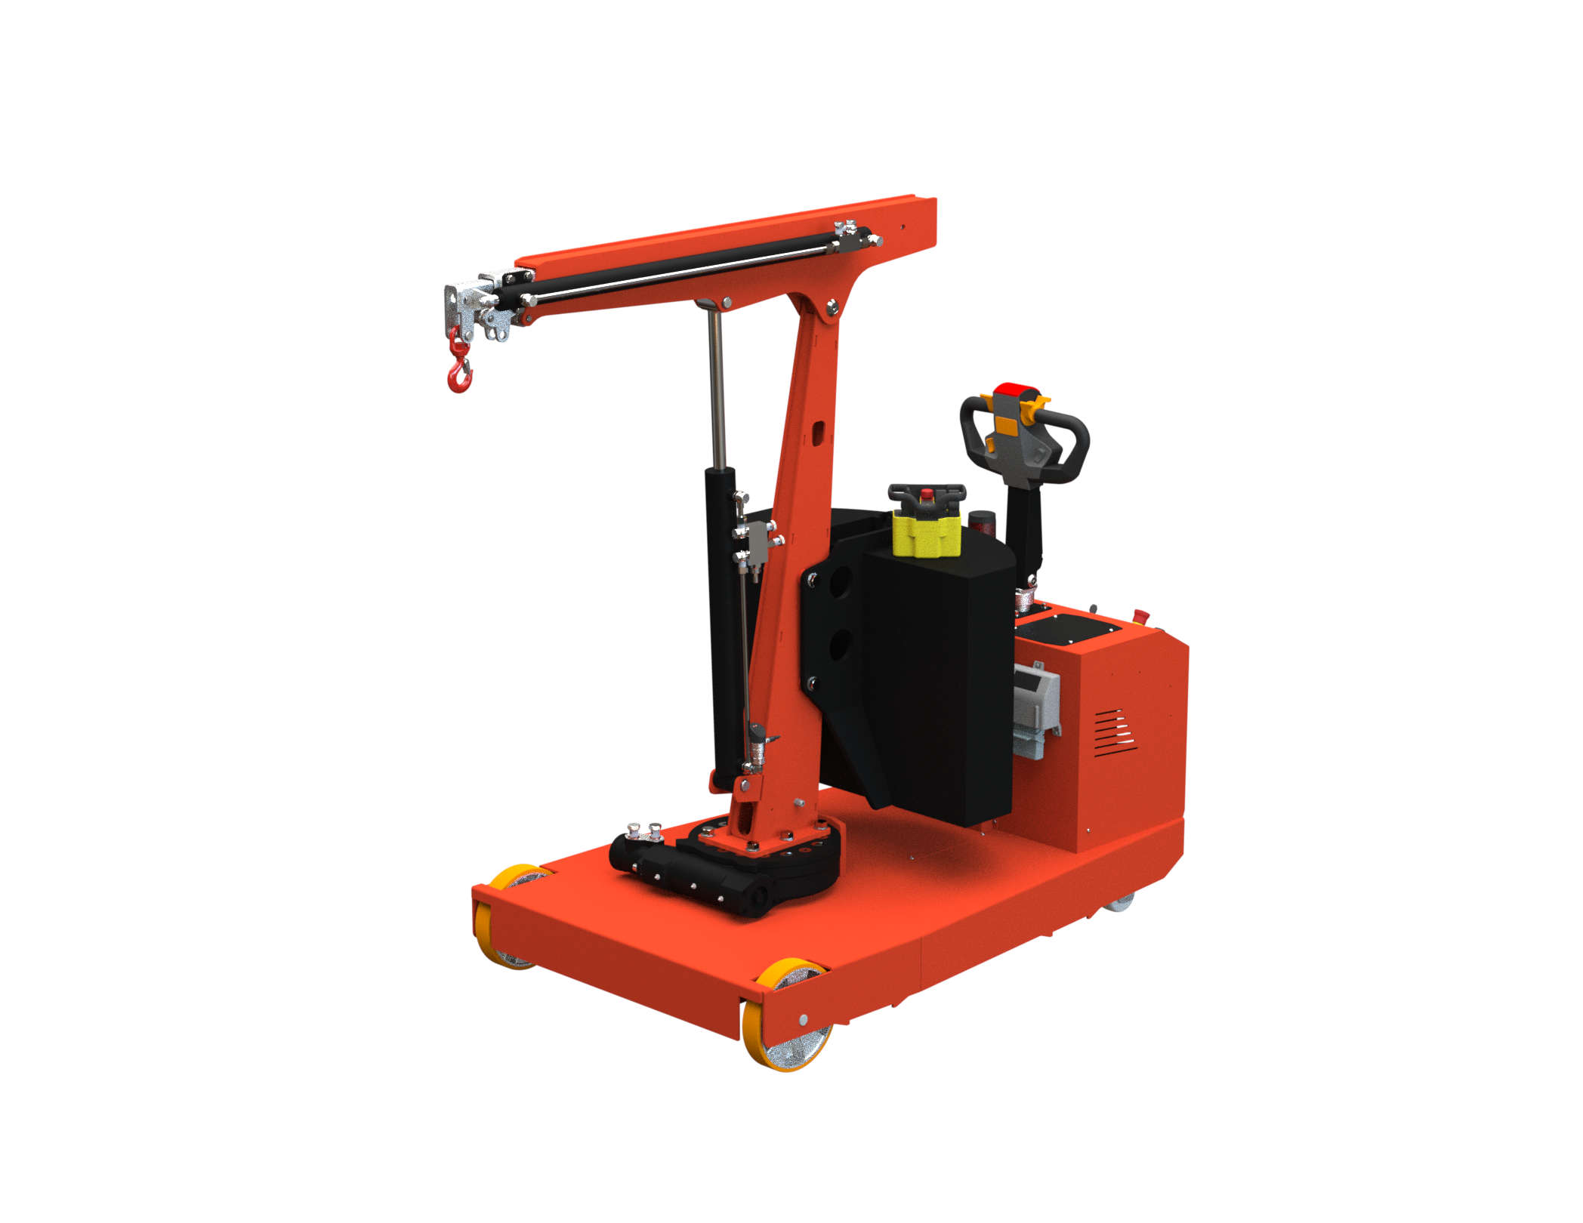
CRANE FLEX G1000DBR
LIFTING CAPACITY 1000 KG
MOTORISED COUNTERBALANCED SWIVEL CRANE
ELECTRIC LIFT/LOWER/EXTEND/RETRACT/ROTATION THROUGH RADIO CONTROL WITH PROPORTIONAL JOYSTICK
Model |  | FLEX G1000DBR
Drive |  | Electric
Rotation |  | 220° electric controlled
Arm lifting |  | Electric – remote control
Arm lowering |  | Electric – remote control
Arm extension |  | Electric – remote control
Width with arm not rotated | mm/inch. | 990 / 39
Width with arm rotated at 90° | mm/inch. | 1120 / 44
Width with arm rotated at 90° and upgrade to optional compact ballast | mm/inch. | 990 / 39 * see drawing below
Max capacity with standard double boom | Kg / lbs. | 1000 / 2204 * see load chart below
Weight of the crane (counterweight incl.) | Kg / lbs. | 1580 / 3483
Battery type standard |  | Maintenance free AGM
Batteries nos. | pcs | 2
Battery voltage / nominal capacity | V / Ah | 12 / 120
Lifting motor | W | 800
Traction motor | W | 1000
Flex Lifting - a brand of AxA Group srl
Via Morandi 21, 40060 Toscanella di Dozza (Bologna) Italy Tel +39 0542673434 email: info@flexlifting.com website: www.flexlifting.com

Slide 2
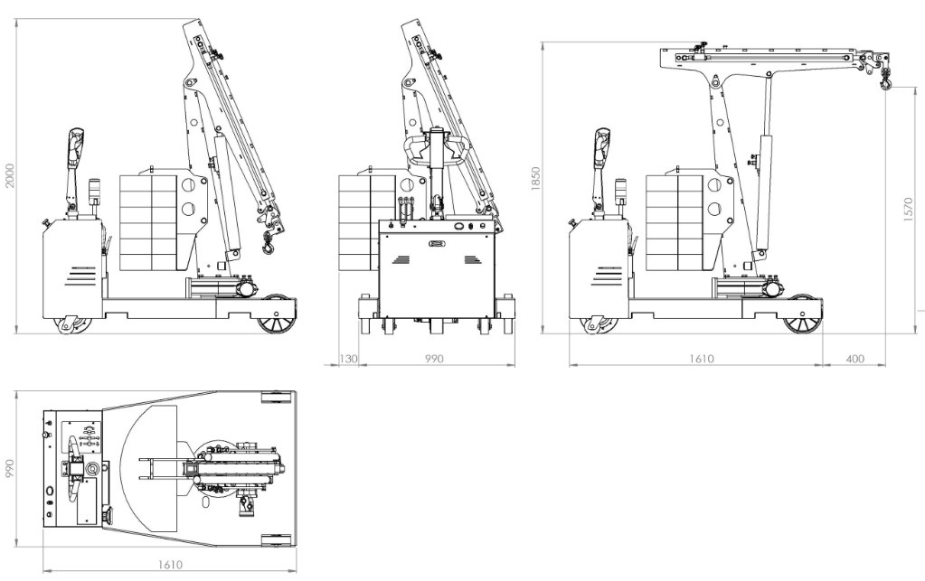
CRANE FLEX G1000DBR
MAIN DIMENSIONS
Flex Lifting – a brand of AxA Group srl
Via Morandi 21, 40060 Toscanella di Dozza (Bologna) Italy Tel +39 0542673434 email: info@flexlifting.com website: www.flexlifting.com

Slide 3
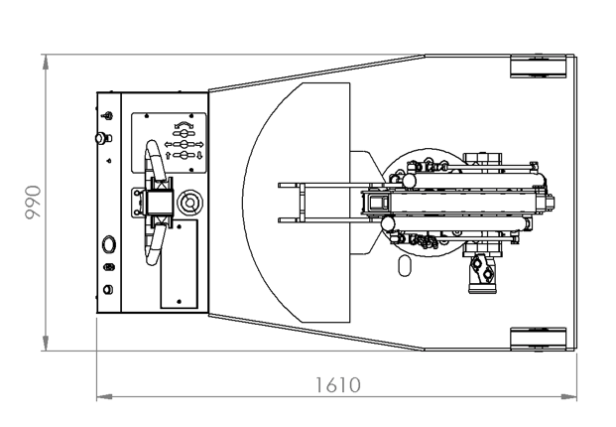
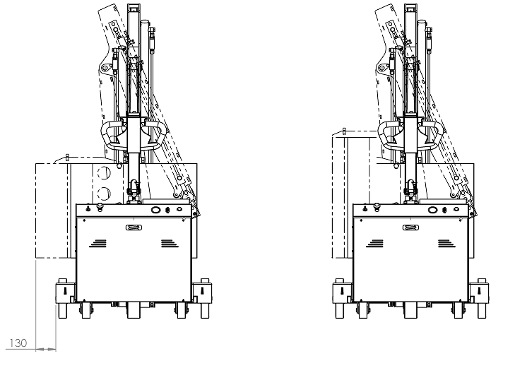
CRANE FLEX G1000DBR
WIDTH WITH COMPACT BALLAST
PB_FLEX G1000DB
WITH STANDARD BALLAST:
WHEN THE ARM IS ROTATED AT 90° THE BALLAST EXCEEDS THE CRANE WIDTH BY 130 MM
UPGRADE TO COMPACT BALLAST
(CODE PB_FLEX G1000DB )
WHEN THE ARM IS ROTATED AT 90° THE BALLAST DOESN’T EXCEED THE CRANE WIDTH OF 990 MM
Flex Lifting – a brand of AxA Group srl
Via Morandi 21, 40060 Toscanella di Dozza (Bologna) Italy Tel +39 0542673434 email: info@flexlifting.com website: www.flexlifting.com

Slide 4
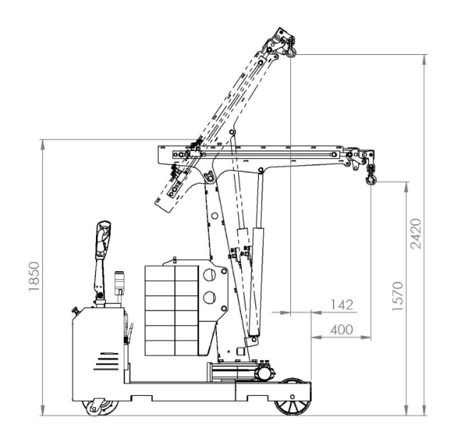
CRANE FLEX G1000DBR
DETAILED DIMENSIONS WITH STANDARD ELECTRIC TELESCOPIC DOUBLE BOOM FULLY RETRACTED
Flex Lifting – a brand of AxA Group srl
Via Morandi 21, 40060 Toscanella di Dozza (Bologna) Italy Tel +39 0542673434 email: info@flexlifting.com website: www.flexlifting.com

Slide 5
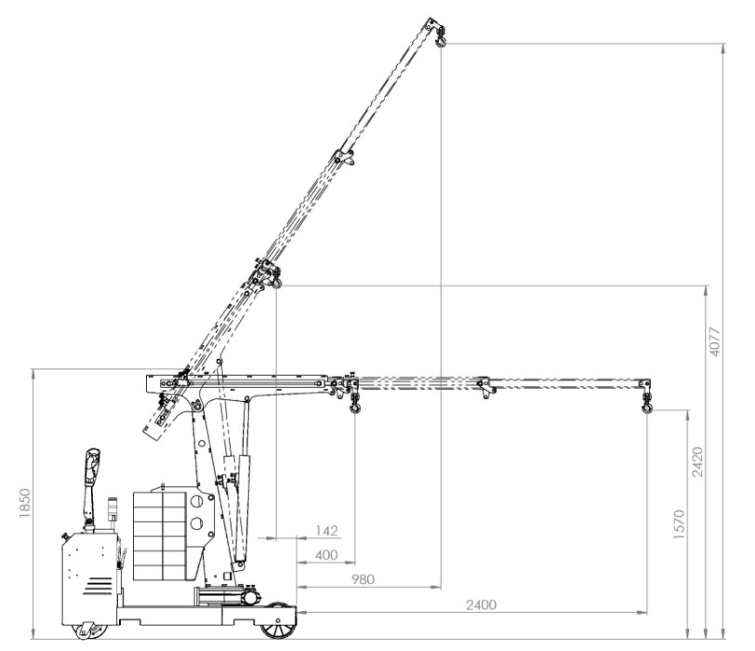
CRANE FLEX G1000DBR
DETAILED DIMENSIONS WITH STANDARD ELECTRIC TELESCOPIC DOUBLE BOOM FULLY EXTENDED
Flex Lifting – a brand of AxA Group srl
Via Morandi 21, 40060 Toscanella di Dozza (Bologna) Italy Tel +39 0542673434 email: info@flexlifting.com website: www.flexlifting.com

Slide 6
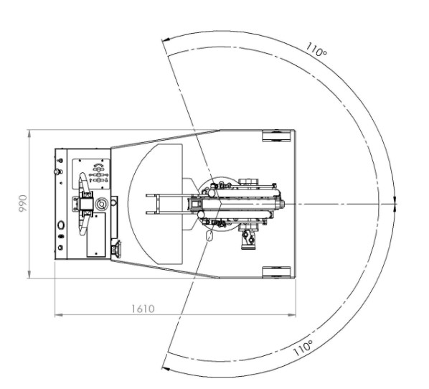
CRANE FLEX G1000DBR
MAIN DIMENSIONS
Flex Lifting – a brand of AxA Group srl
Via Morandi 21, 40060 Toscanella di Dozza (Bologna) Italy Tel +39 0542673434 email: info@flexlifting.com website: www.flexlifting.com

Slide 7
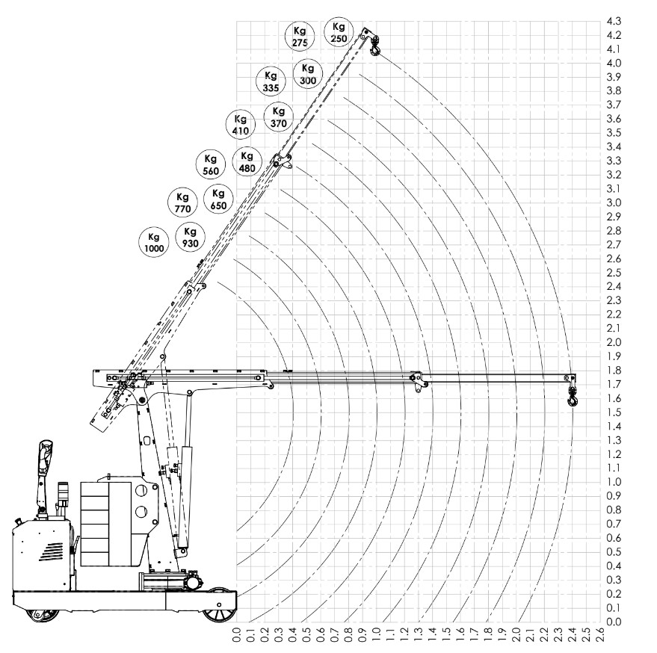
CRANE FLEX G1000DBR
LOAD CHART WITH STANDARD ELECTRIC TELESCOPIC DOUBLE BOOM
Flex Lifting – a brand of AxA Group srl
Via Morandi 21, 40060 Toscanella di Dozza (Bologna) Italy Tel +39 0542673434 email: info@flexlifting.com website: www.flexlifting.com

